Slide 1

Hotel Reservation System
Presented By- Guided By-
Anushree Joshi Prof. Indrakka Mali
Shivani Gole
Anupriya Kannan
Kausar Sheikh
Sangeetha T R
Priyanka Parab

Slide 2
Contents
Introduction
ER Diagram
Working of Back-End
Annotations
APIs
Software Requirement
Features Of System
Conclusion

Slide 3
Introduction
Hotel Reservation System is used to book the hotel room and choose menu according to customer choice.
Hotel Manager can insert, delete the record of rooms and menu.
Customer can add their information and can book hotel rooms and menu.

Slide 4
ER Diagram
Menu Customer Room
menuId
menuName
Price
customerId
customerId
customerName
customerContactNo
roomNo
roomType
roomPrice
Many to One
One to One

Slide 5
Working of Back-End
Client
UI Controller
Service
Repository
Database

Slide 6
Work Flow
Client send a request to server for different options like inserting ,fetching ,update and delete a data.
When client hit on request .Request goes to the Controller Class and use respective URL to take data .
Then control of URL goes to the service Class And Conditions get Executed.
For returning response to client use same sequence. Service To Control Class.
Here Repository class is used to interact with database using Hibernate Technology.

Slide 7
Annotations
Annotations are used to provide supplemental information about a program.
Annotations start with ‘@’.
@Id: This id annotation is used to declare attribute as primary.
@GeneratedValue: Used to generate value automatically when use insert new record
@size: Used in collection for specific minimum and maximum length for a string.
@NotNull: This gives mandatory filed to enter data.

Slide 8
Annotations
@ManyToOne: To create the many-to-one relationship between the Menu and customer entities.
@JoinColumn: helps us specify the column we'll use for joining.
@JsonIgnore: Is used to ignore the logical property used in serialization and deserialization.
@Entity: is used is used to mark this class as an Entity bean.
OneToMany: is used to create the one-to-many relationship between the customer and menu entities
Cascadetype.All: ensure that all persistence events such as persist, refresh, merge and remove that occur on the parent, will be passed to the child.

Slide 9
Annotations
@override: Informs the compiler that the element is meant to override an element declared in a superclass.
@RestController: This annotation is used at the class level and allows the class to handle the requests made by the client.
@Autowired: Enables you to inject the object dependency implicitly.
@ControllerAdvice: Allows to handle exceptions across the whole application in one global handling component.

Slide 10
Annotations
@ResponseStatus: To mark a method or an exception class with a status code and reason that should be returned.
@ExceptionaHandler : Used to handle the specific exceptions and sending the custom responses to the client.
@Service:It is used to mark the class as a service provider.
@OneToOne: One to one represents that a single entity is associated with a single instance of the other entity.

Slide 11
Application programming interface
For Customer Class
/addCustomer- (@PostMapping) using this url customer can add their details.
/getCustomer- (@GetMapping) using this url user can see all customers details
/getCustomerById/{cid}- (@GetMapping) using this url user can see particular customer details.
deleteCustomer/{cid}- (@DeleteMapping) using this url user can delete particular customer details.
/room/{roomno}/customer/{cid}-(@PutMapping) using this url user can assign particular room to particular customer.

Slide 12
Application programming interface
/addMenu-(@PostMapping) using this url manager can add menu
/getMenu-(@GetMapping) using this url user can see all the menu list
/getMenuByName/{menuname}- (@GetMapping) using this url user can see particular menu by entering the menu name.
/menu/{menuid}/customer/{cid}-(@PutMapping) using this url user can assign particular menu to particular customer.
/deleteMenu/{cid}-(@DeleteMapping) using this url user can delete menu which is assign to the customer.

Slide 13
Application programming interface
/addRoom-(@PostMapping) using this url user can add room.
/getRoom-(@GetMapping) using this url user can see all the rooms.
/getRoomByNo/{roomno}-(@GetMapping) using this url user can see room the particular room.
/deleteRoom/{roomno}-(@DeleteMapping) using this url user can delete the room.

Slide 14
Application programming interface
For payment-
/payment-(@PostMapping) using this url customer can do payment.
/getAllPayments(@GetMapping) using this url manager can see all the payments.
/checkTotalMoneyInHotel (@GetMapping) using this url manager can check total payment.
Bill-
/bill/room/{roomno}/customer/{cid} (@GetMapping) using this url user can see the bill.

Slide 15
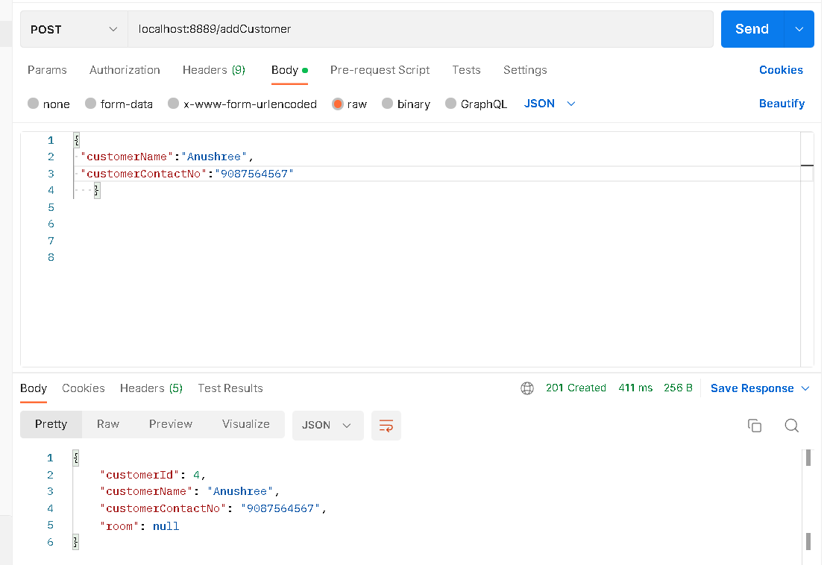
Execution using postman

Slide 16
Software and hardware used
Software Requirements
Operating System : Windows 11
Language : Java
IDE : Spring Tool Suite
Client : Postman
Backend : MySQL
Hardware Requirements
CPU : Intel i3 processor
RAM : 4 GB or above
Hard Disk : 1TB hard disk space or minimum

Slide 17
Features
By using Hotel Reservation System user can perform so many operations using url ex. Insert, update, delete, fetch.
Customer can book room and menu.
Hotel Manager can see all the details related to customer, room, menu, payment, total balance.

Slide 18
conclusion
Performing CRUD operations on the database.
Creating Rest APIs.
Implementing Spring Security.
Handle Exceptions.
Create association between entities.

Slide 19
Thank you!

